Slide 1


E-Commerce Management System
Target 2.0
Course: DAMG6210 Professor: Simon Wang Project Team 3: Yang Zheng, Mengyun Xie, Chenni Xu

Slide 2
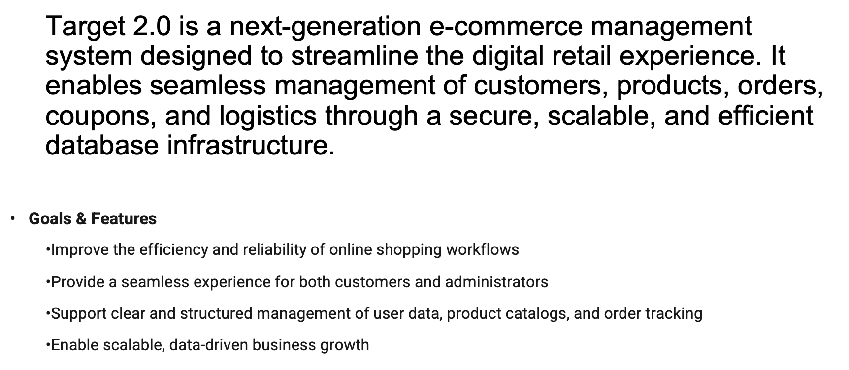
Overview

Slide 3









Core Objectives
Customer & Account Management
Manage customer identity, profiles, and payment preferences to enable secure and personalized shopping experiences.
Product & Inventory
Maintain a structured and searchable product catalog with real-time stock tracking.
Ordering & Promotion System
Support the full shopping and purchasing workflow, from cart to checkout to delivery tracking. Boost sales and engagement with dynamic discount features.
Customer Interaction
Facilitate user engagement and support to improve satisfaction and trust.

Slide 4
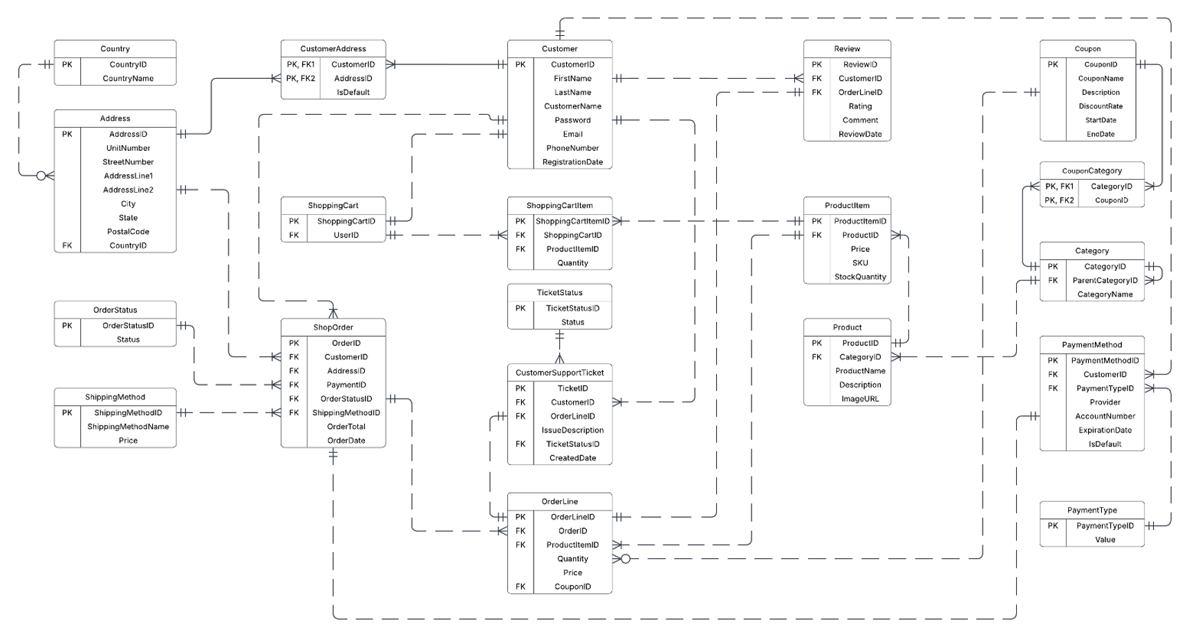
Entity Relationship Diagram

Slide 5




Database Implementation
DDL
Computed Column
Column Data Encryption
Table Level
Check Constraints
Stored Procedures
Trigger
DML
Views

Slide 6
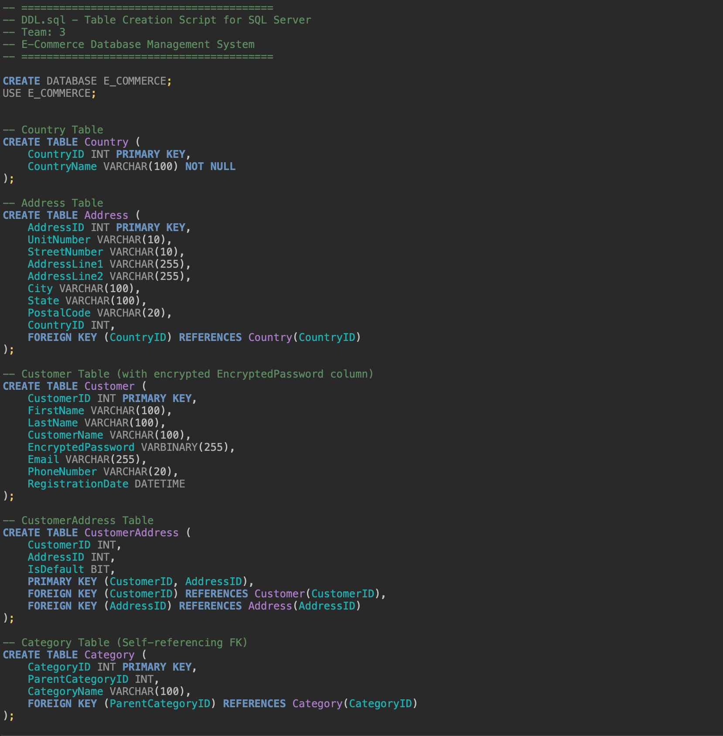
DDL.SQL
DATA DEFINITION LANGUAGE
Country
Address
Customer
CustomerAddress
Category
Product
ProductItem
ShoppingCart
ShoppingCartItem
PaymentType
PaymentMethod
ShippingMethod
OrderStatus
ShopOrder
Coupon
CouponCategory
OrderLine
Review
TicketStatus
CustomerSupportTicket

Slide 7
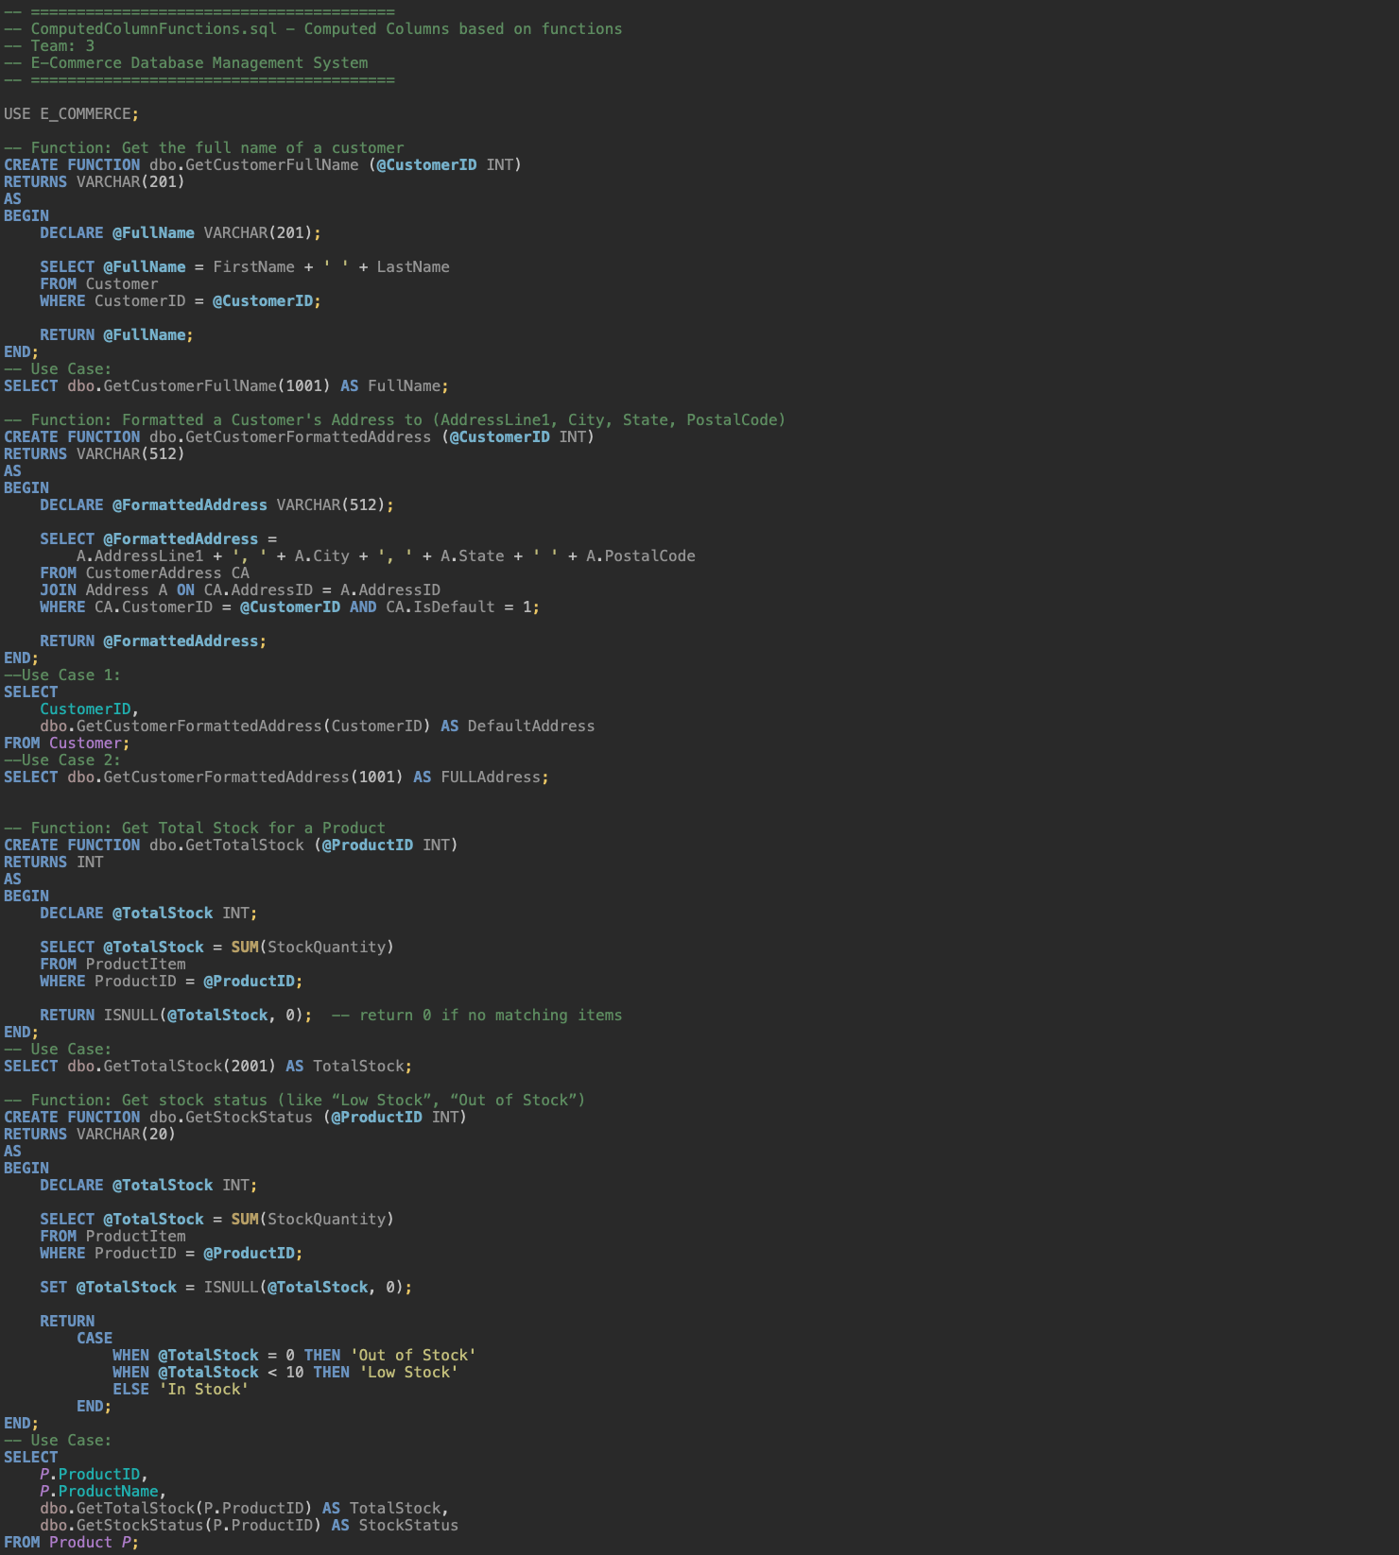
ComputedColumn.SQL
GetCustomerFullName()
GetCustomerFormattedAddress()
GetTotalStock()
GetStockStatus()
GetTop5BestSellers()
GetOrderGrandTotal()
GetUnsolvedTickets()

Slide 8

ColumnDataEncryption.SQL
Sensitive Data Protection

Slide 9
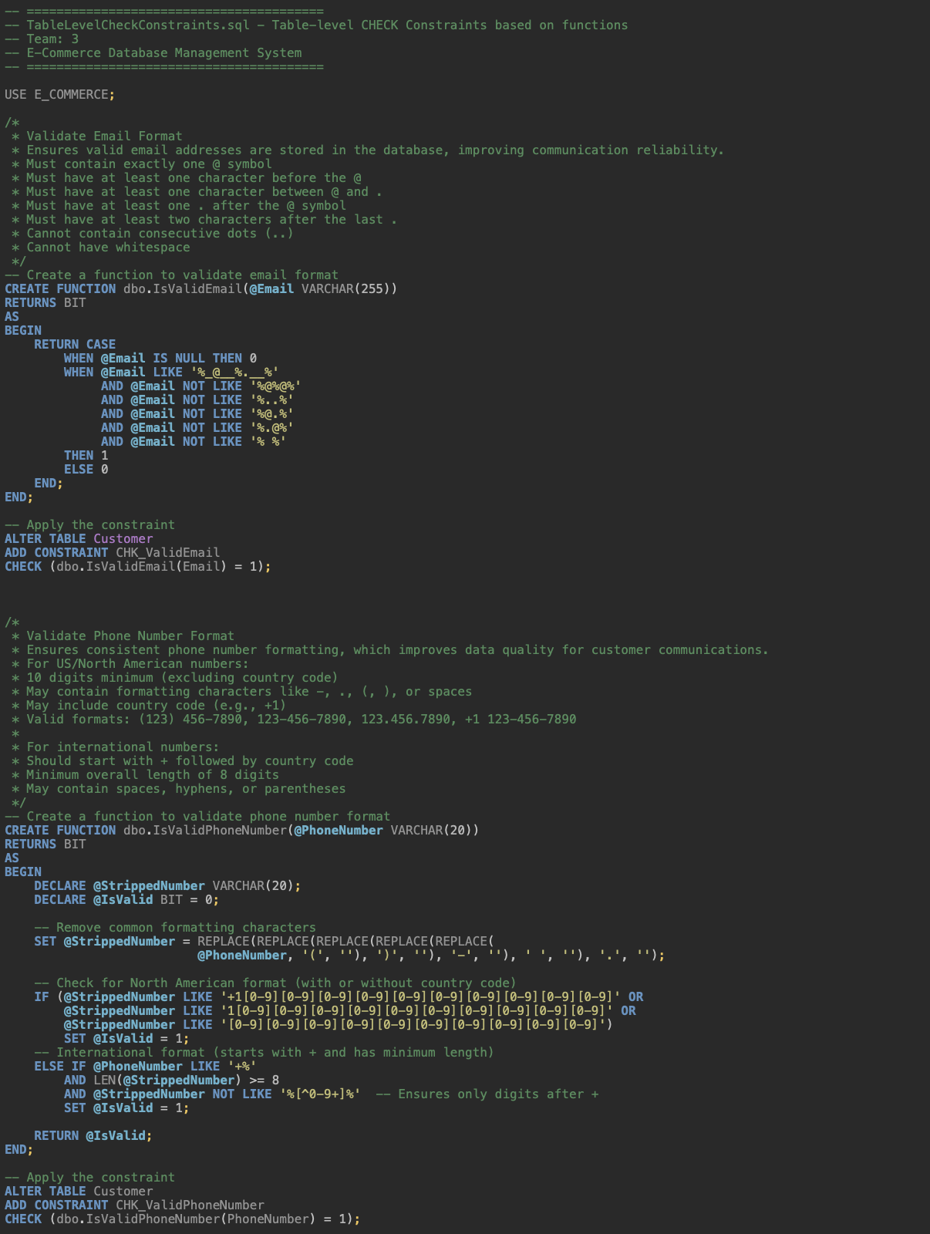
TableLevelCheckConstraints.SQL
IsValidEmail
Must contain exactly one @ symbol
Must have at least one character before the @
Must have at least one character between @ and .
Must have at least one . after the @ symbol
Must have at least two characters after the last .
Cannot contain consecutive dots (..)
Cannot have whitespace
IsValidPhoneNumber
For US/North American numbers:
10 digits minimum (excluding country code)
May contain formatting characters like -, ., (, ), or spaces
May include country code (e.g., +1)
Valid formats: (123) 456-7890, 123-456-7890, 123.456.7890, +1 123-456-7890
For international numbers:
Should start with + followed by country code
Minimum overall length of 8 digits
May contain spaces, hyphens, or parentheses

Slide 10
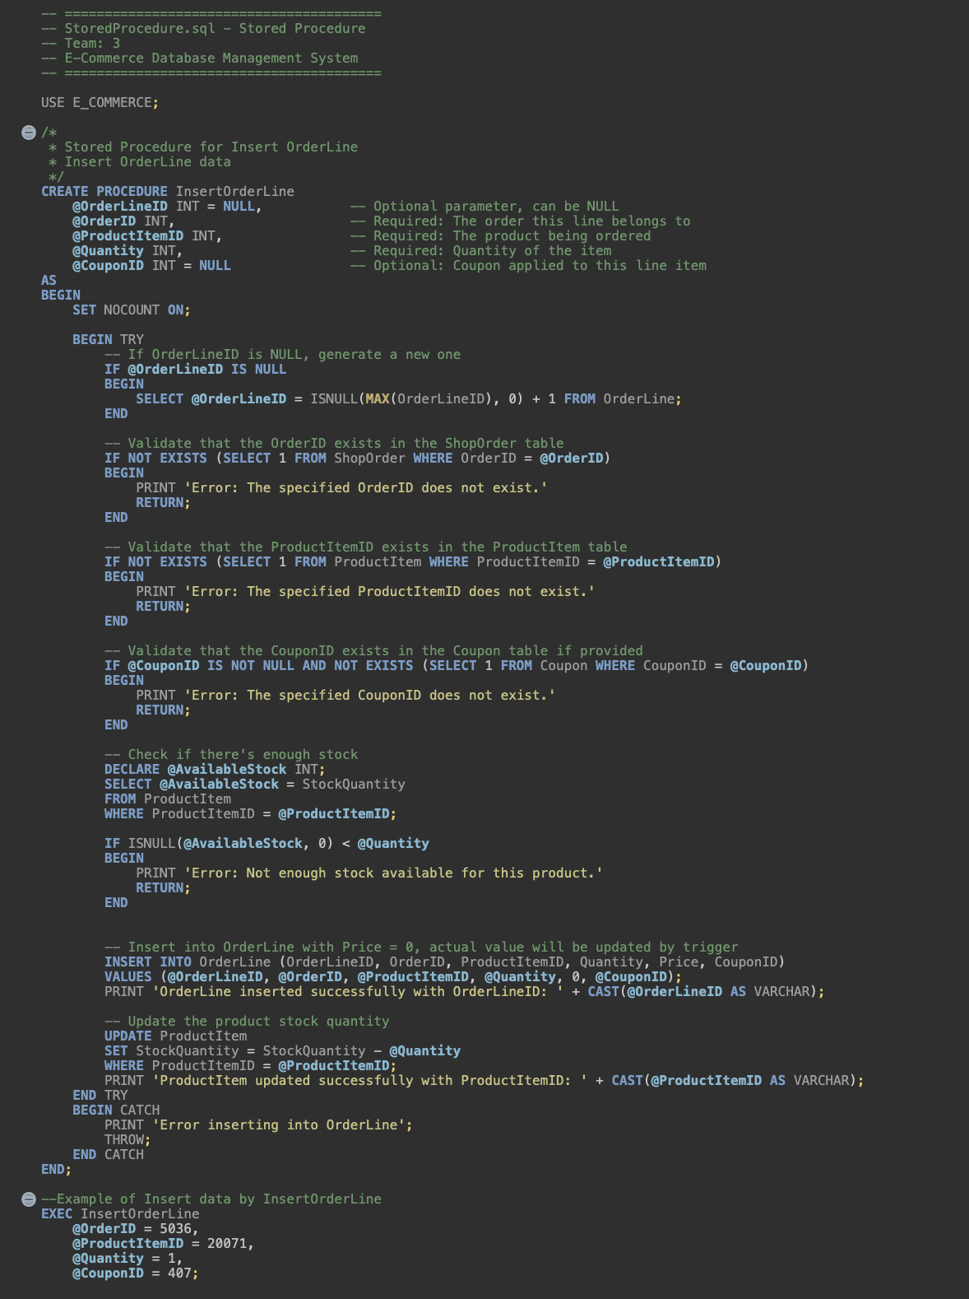
StoredProcedures.SQL
InsertOrderLine
Automatically generates OrderLineID if not provided.
Validates OrderID, ProductItemID, and optional CouponID exist.
Checks product availability and updates StockQuantity after insertion.
Returns success or validation error messages.
DeleteOrderLine
Checks OrderLine Before delete.
Delete the order line
Restore the product’s stock quantity upon deletion.
InsertShopOrder
Automatically generates OrderID and OrderDate if not provided.
Validates CustomerID, AddressID, PaymentID,OrderStatusID, and ShippingMethodID exist.
Ensures the order date is not in the future and the payment method is not expired.
Returns a success message or detailed validation errors.

Slide 11
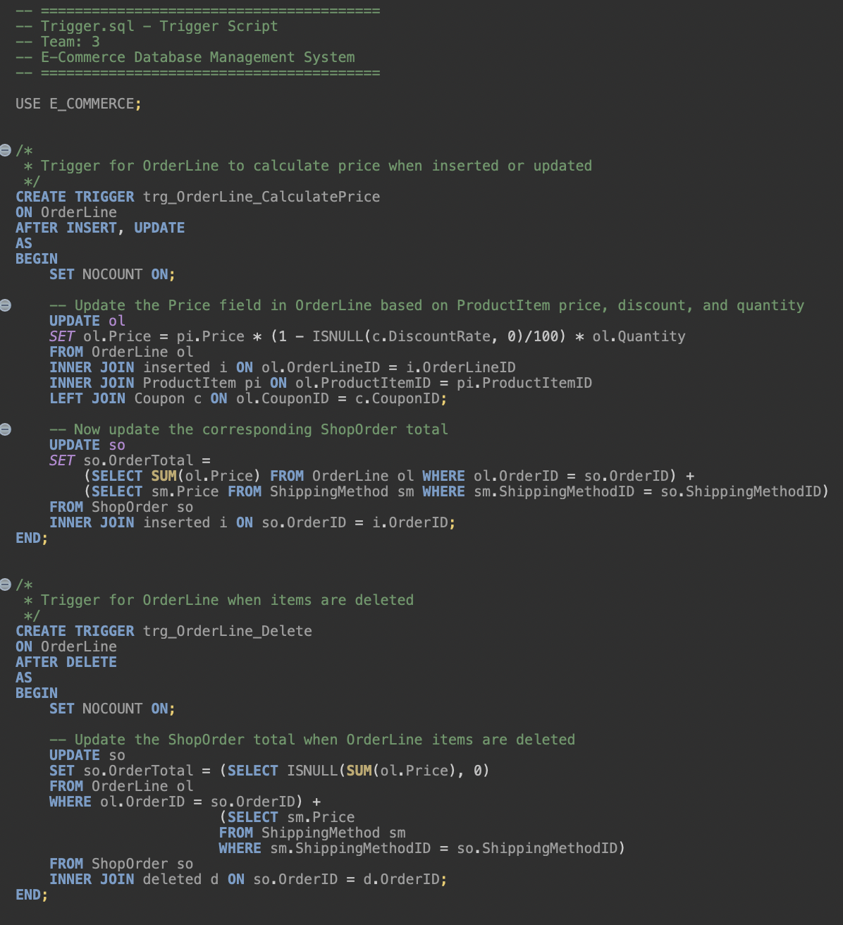
Trigger.SQL
trg_OrderLine_CalculatePrice
On INSERT or UPDATE, the Price is calculated using the associated ProductItem price, quantity, and optional Coupon discount.
Then Update the corresponding ShopOrder total.
trg_OrderLine_Delete
Update the ShopOrder total when OrderLine items are deleted

Slide 12
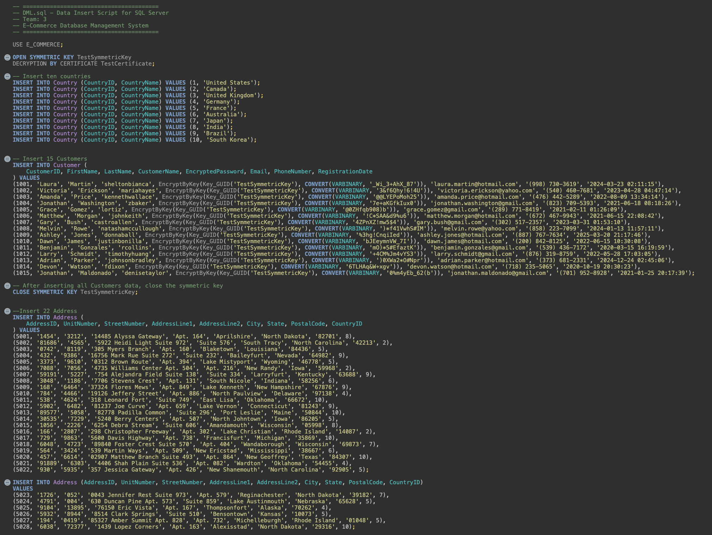
DML.SQL

Slide 13
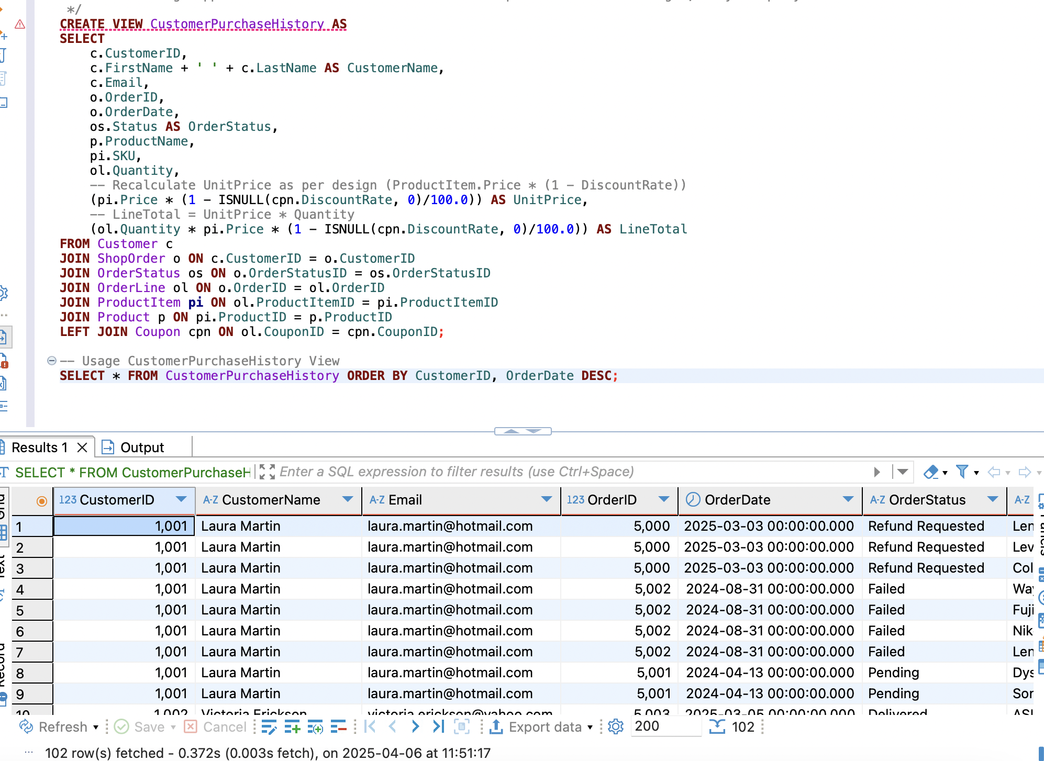
Views
Customer Purchase History
This helps customer service representatives quickly view a customer's complete purchase history

Slide 14
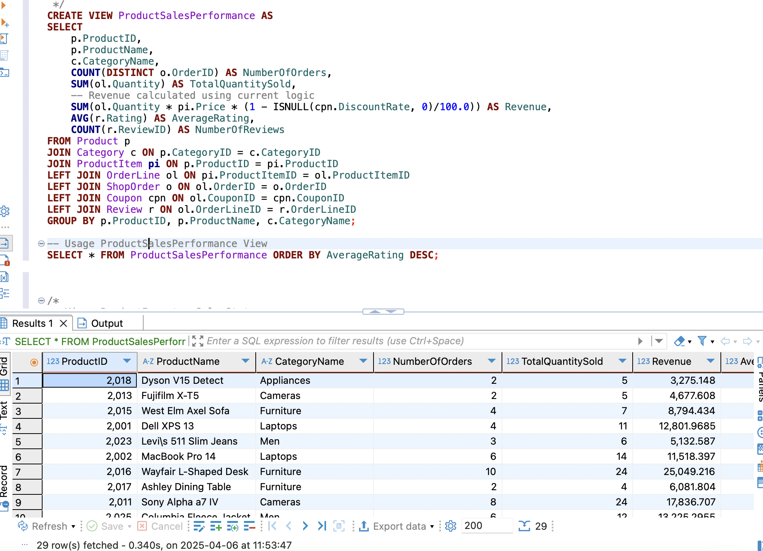
Views
Product Sales Performance
Marketing and product teams use this view to identify top-performing products, analyze sales patterns,
and make inventory decisions. The view combines sales data with customer reviews to provide a comprehensive performance picture.

Slide 15
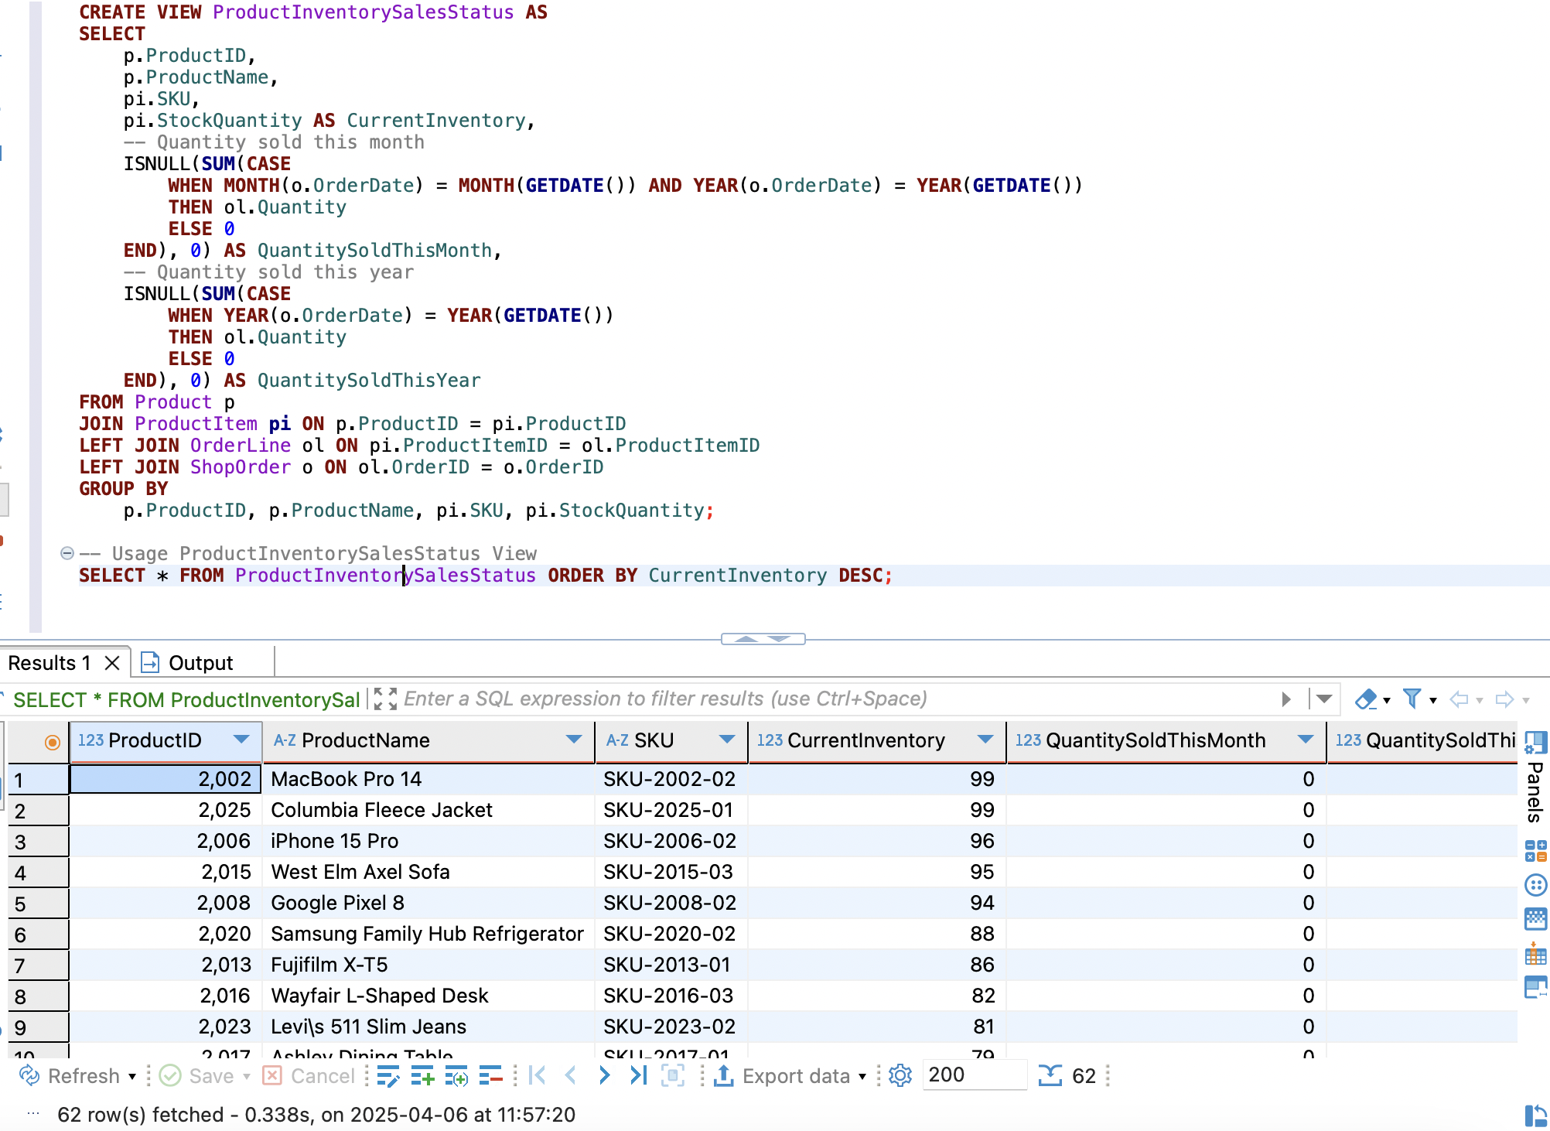
Views
Product Inventory Sales Status
It joins product, product item, order line, and order data, and groups results by product and SKU. This view is useful for inventory tracking, sales analysis, and restocking decisions.

Slide 16
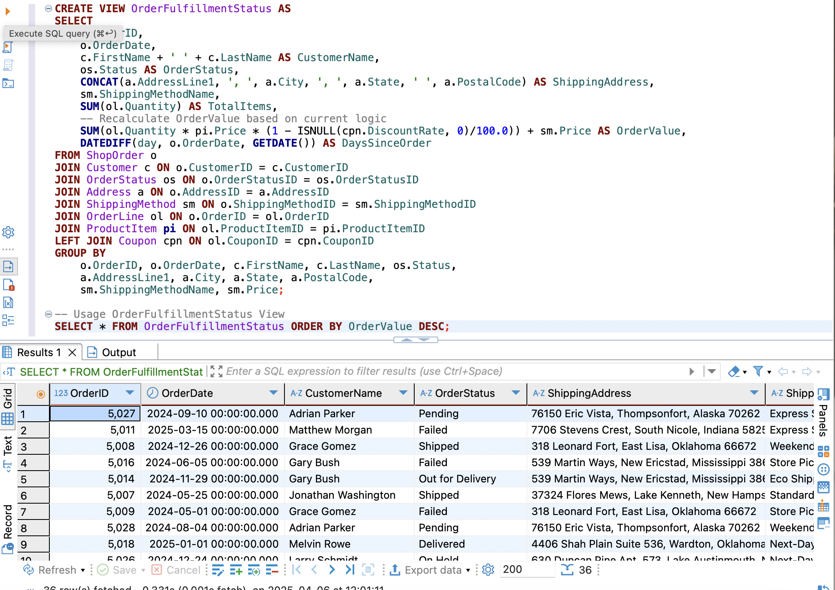
Views
Order Fulfillment Status
Warehouse and shipping teams use this view to manage order fulfillment priorities and track processing times. It provides a complete picture of orders that need to be processed,packed, and shipped.

Slide 17
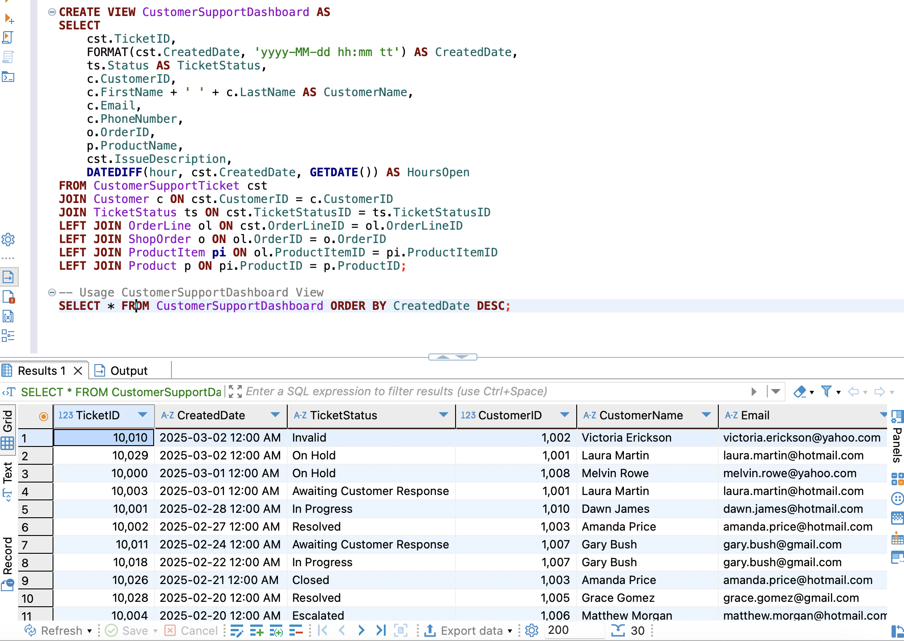
Views
Customer Support Dashboard
Customer support representatives use this view to manage and prioritize support tickets. It provides essential context about customers and their issues,helping to streamline the support process.

Slide 18
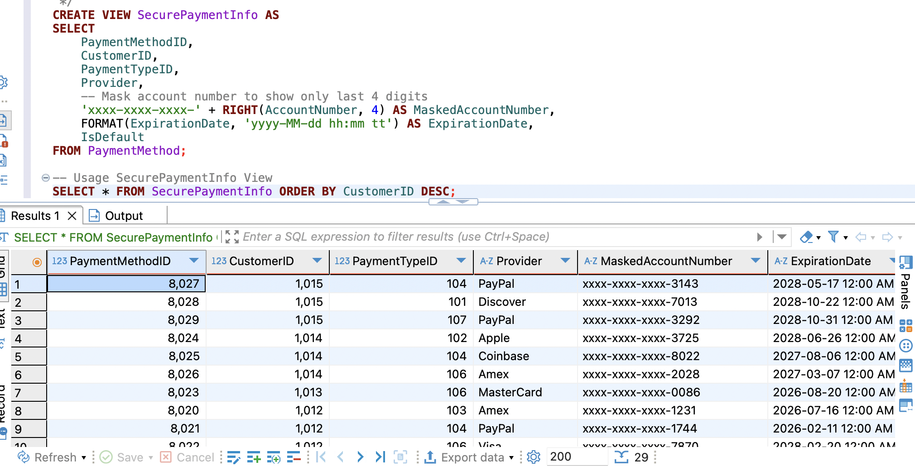
Views
Secure Payment Info
Customer service representatives need to see payment methods to help customers but should not have access to complete account numbers. This view masks sensitive information while providing necessary context.

Slide 19
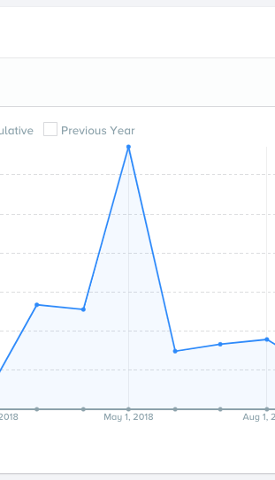
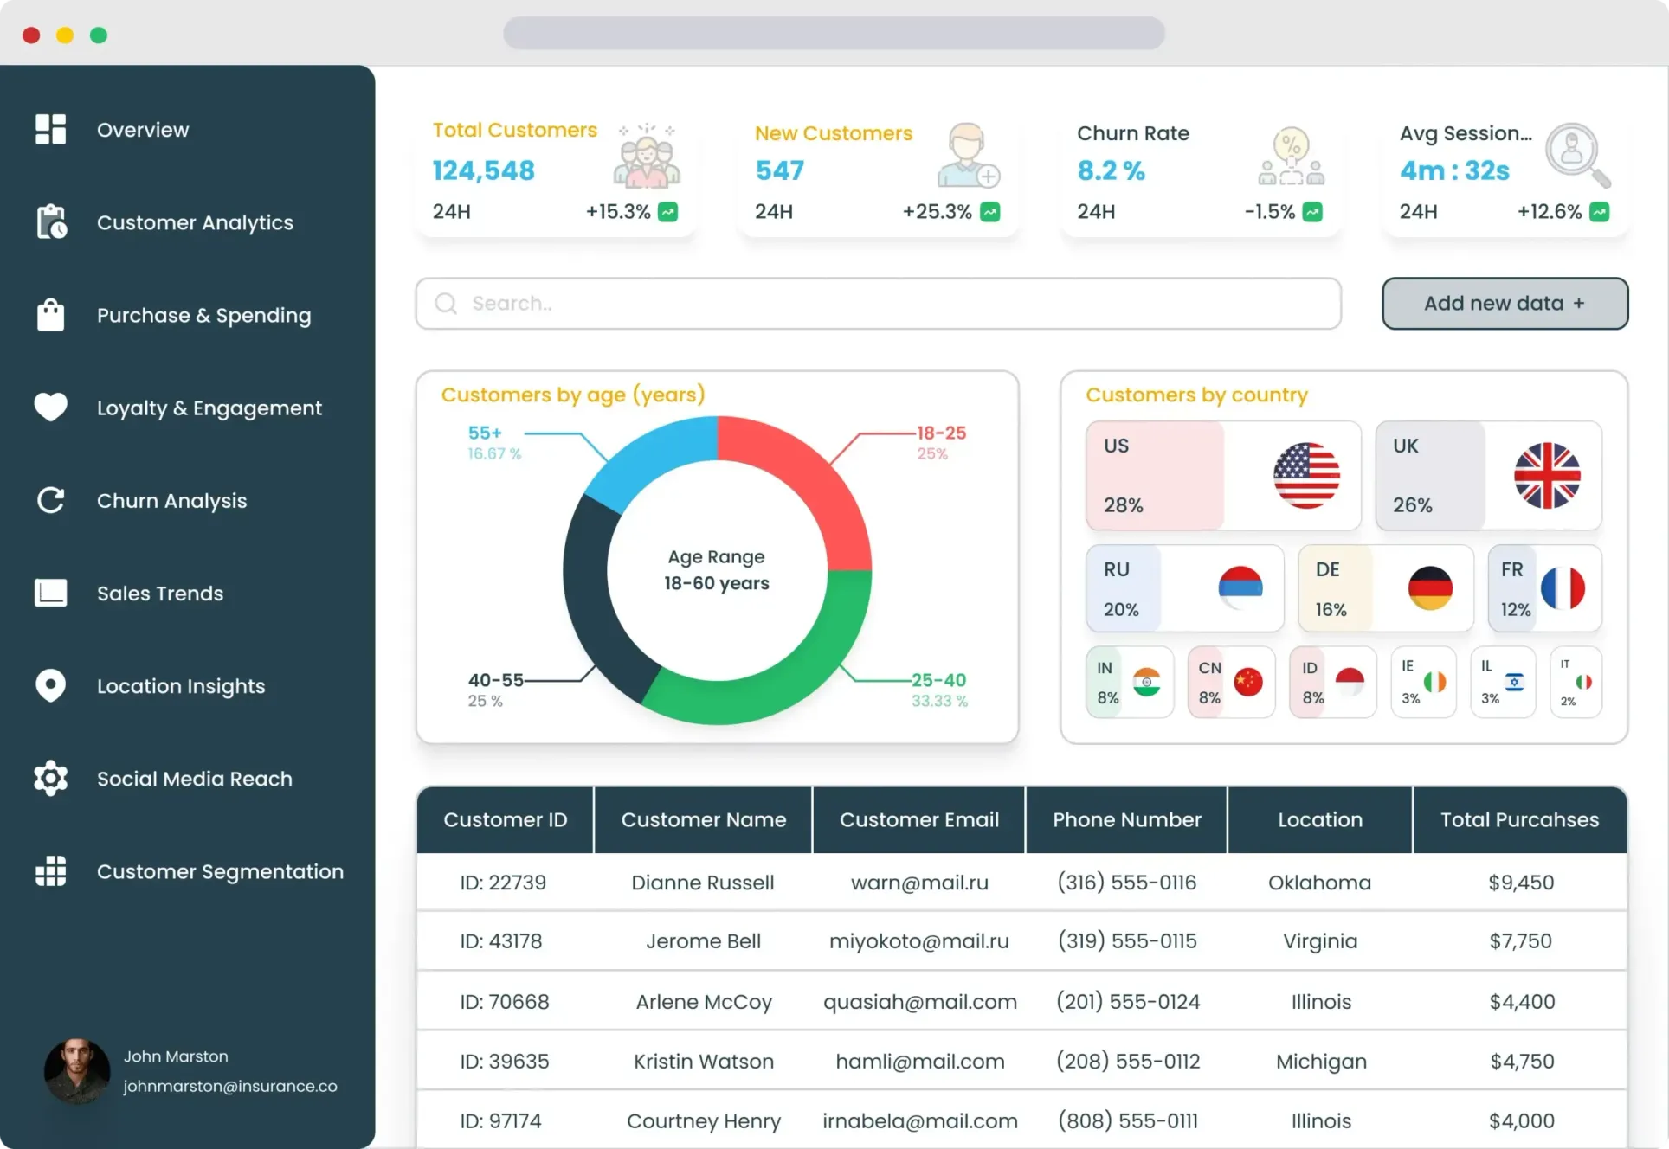
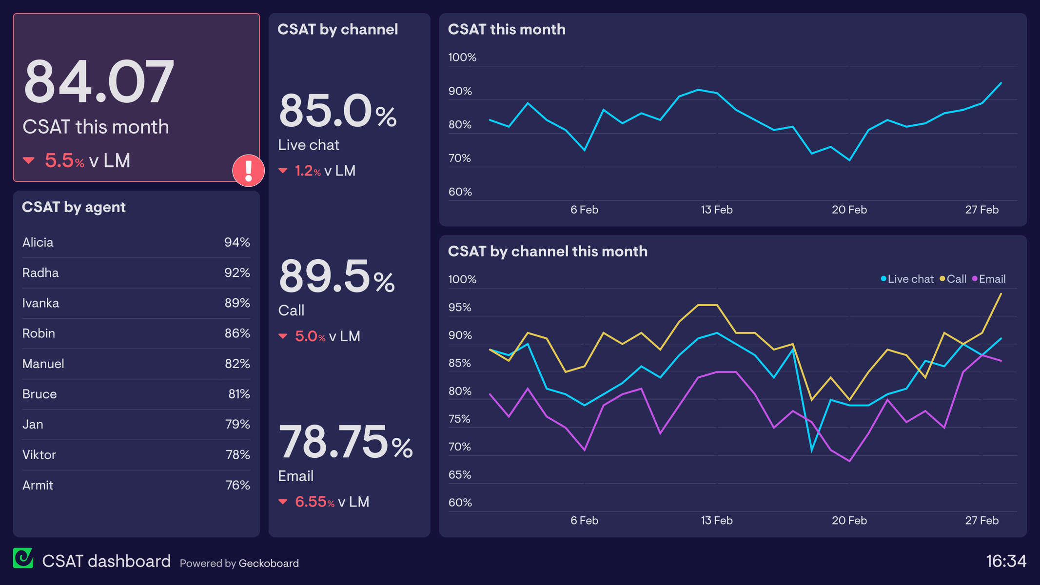
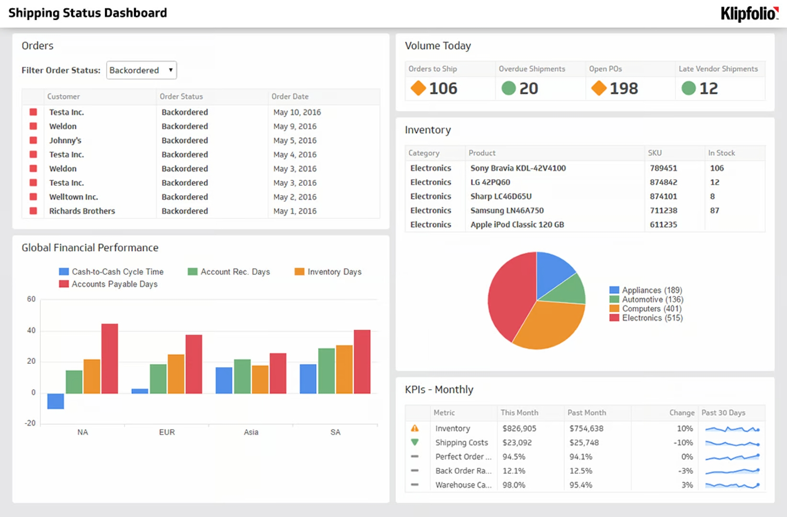
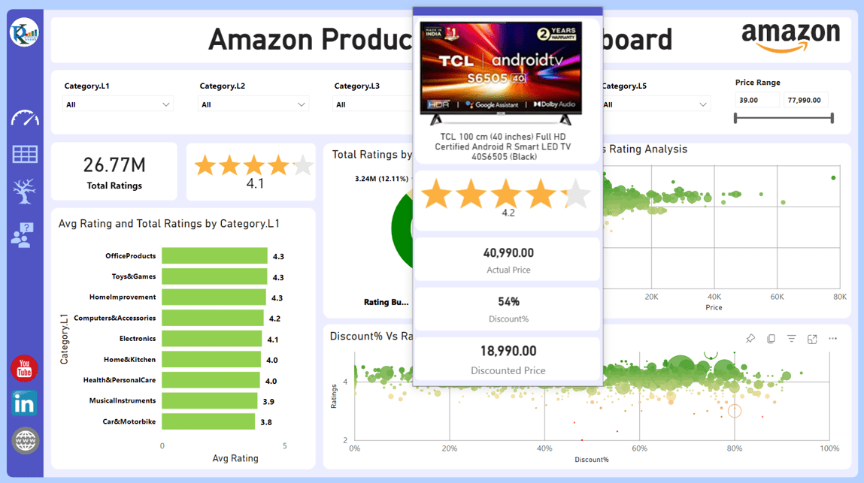
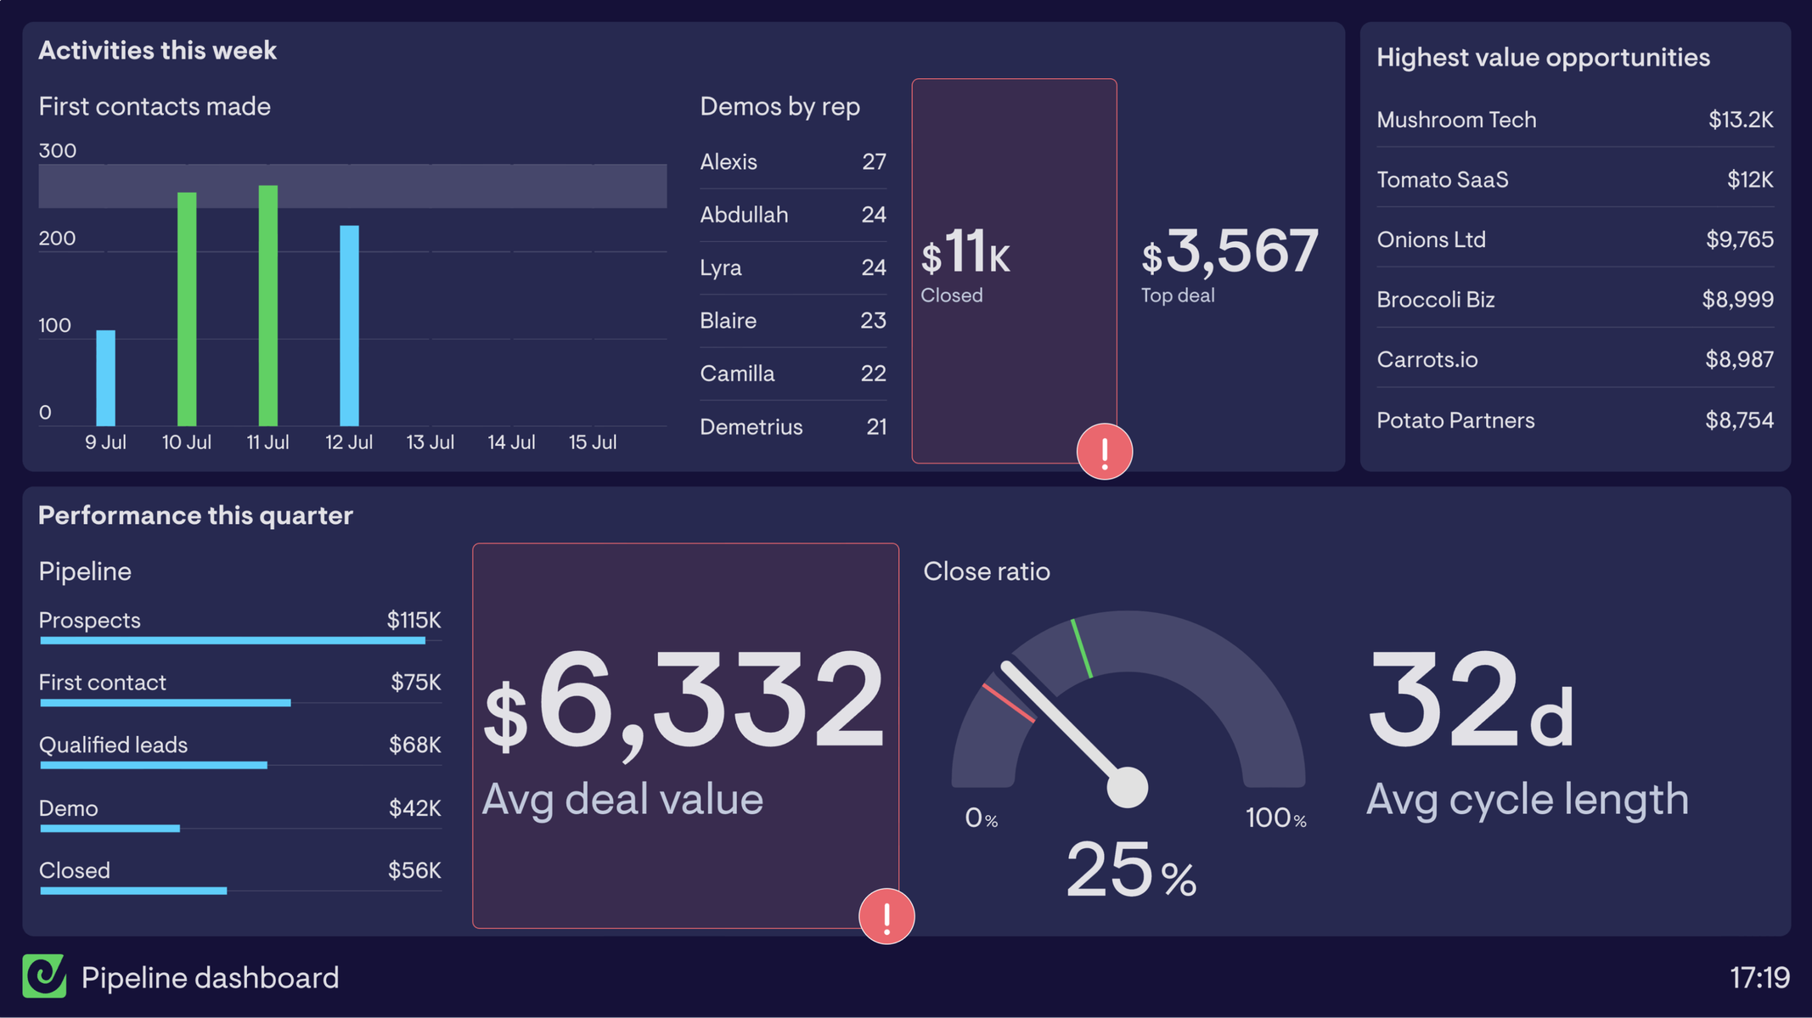
Real-Time Insights
COUPON DISCOUNT IMPACT
CUSTOMER INSIGHTS
CUSTOMER SUPPORT DASHBOARD
INVENTORY DASHBOARD
PRODUCT RATINGS DASHBOARD
SALES DASHBOARD
Tracking of sales performance, revenue, and key business metrics.
Visualization displaying the impact of coupons on sales and revenue.
Dashboards providing in-depth analysis of customer behavior and preferences.
Comprehensive view of product inventory levels, trends, and forecasting.
Visualizations of product ratings, reviews, and customer feedback.
Real-time monitoring of customer inquiries, issues, and response times.

Slide 20
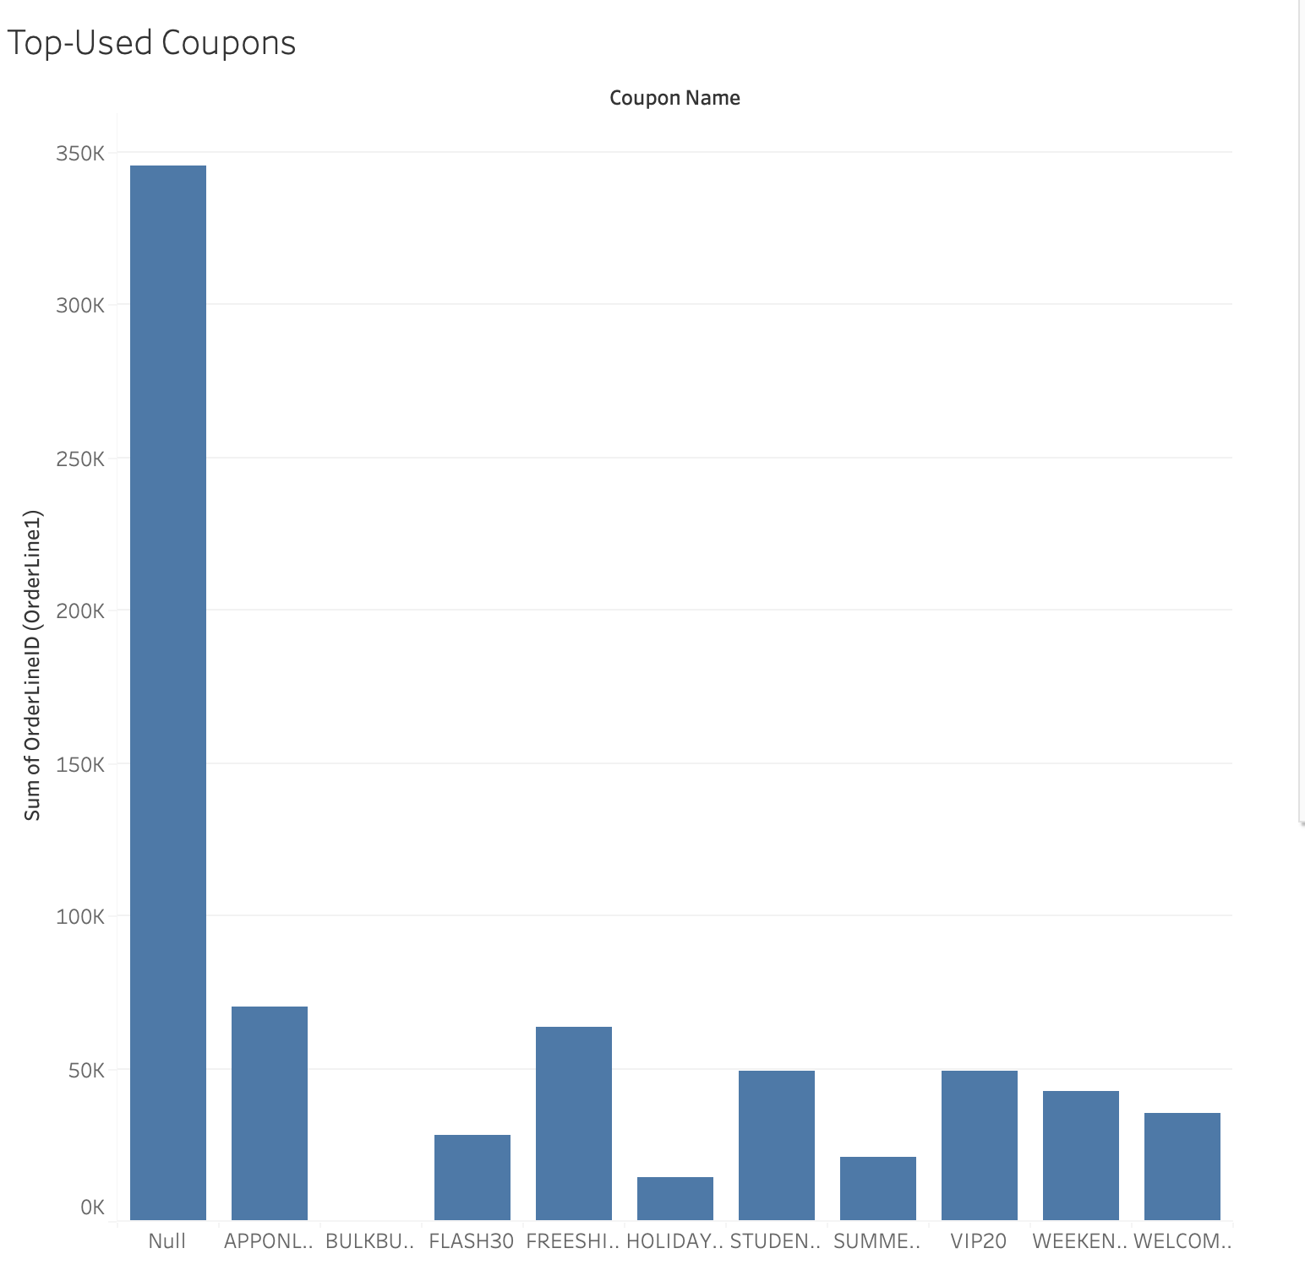
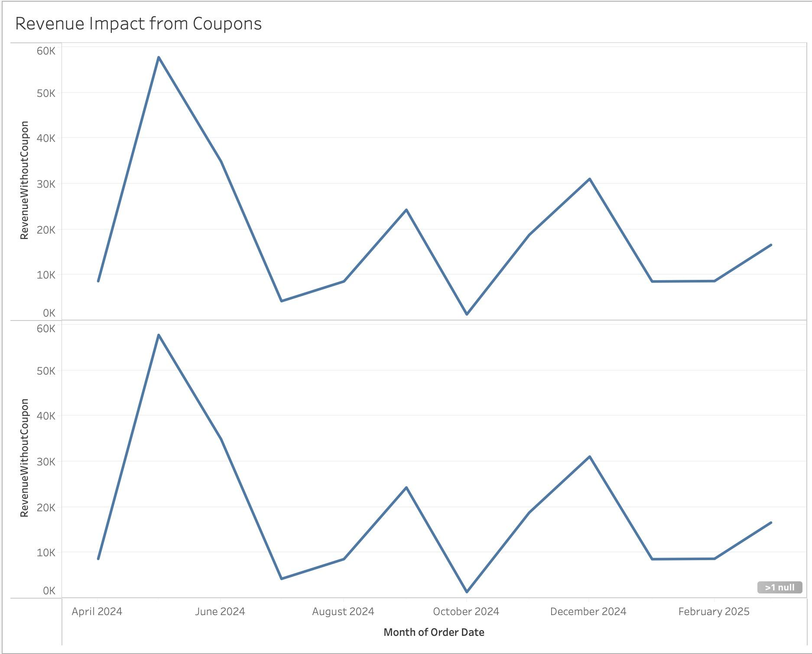
COUPON DISCOUNT IMPACT

Slide 21
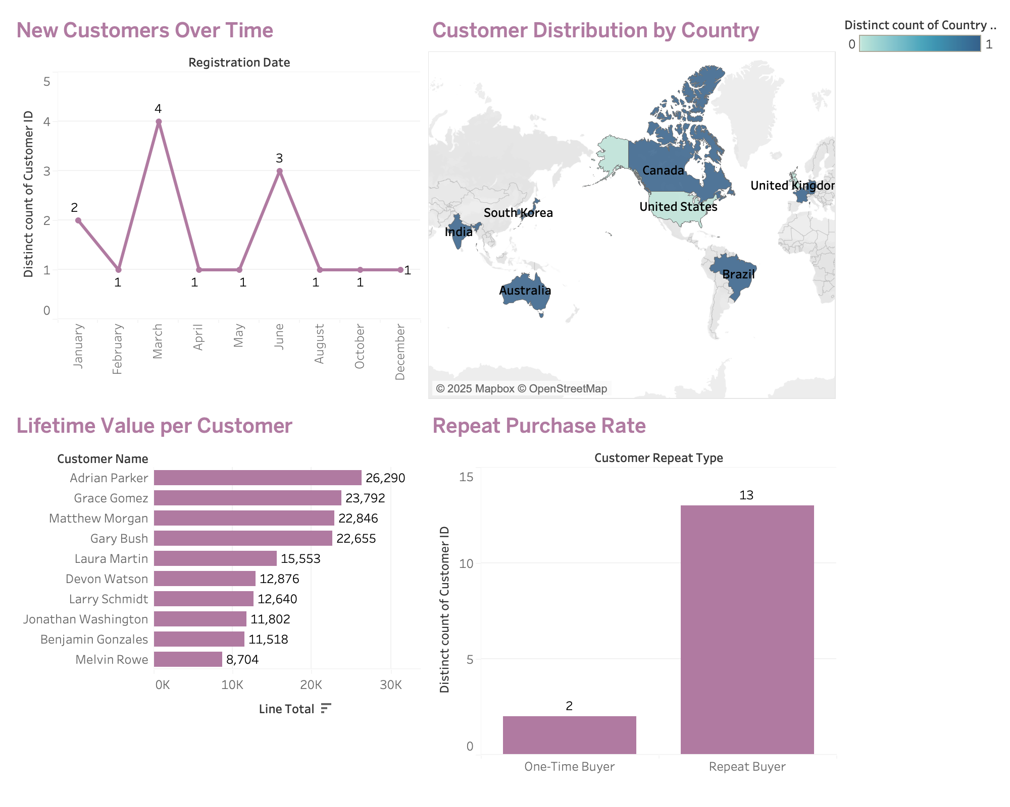
Customer Insights

Slide 22
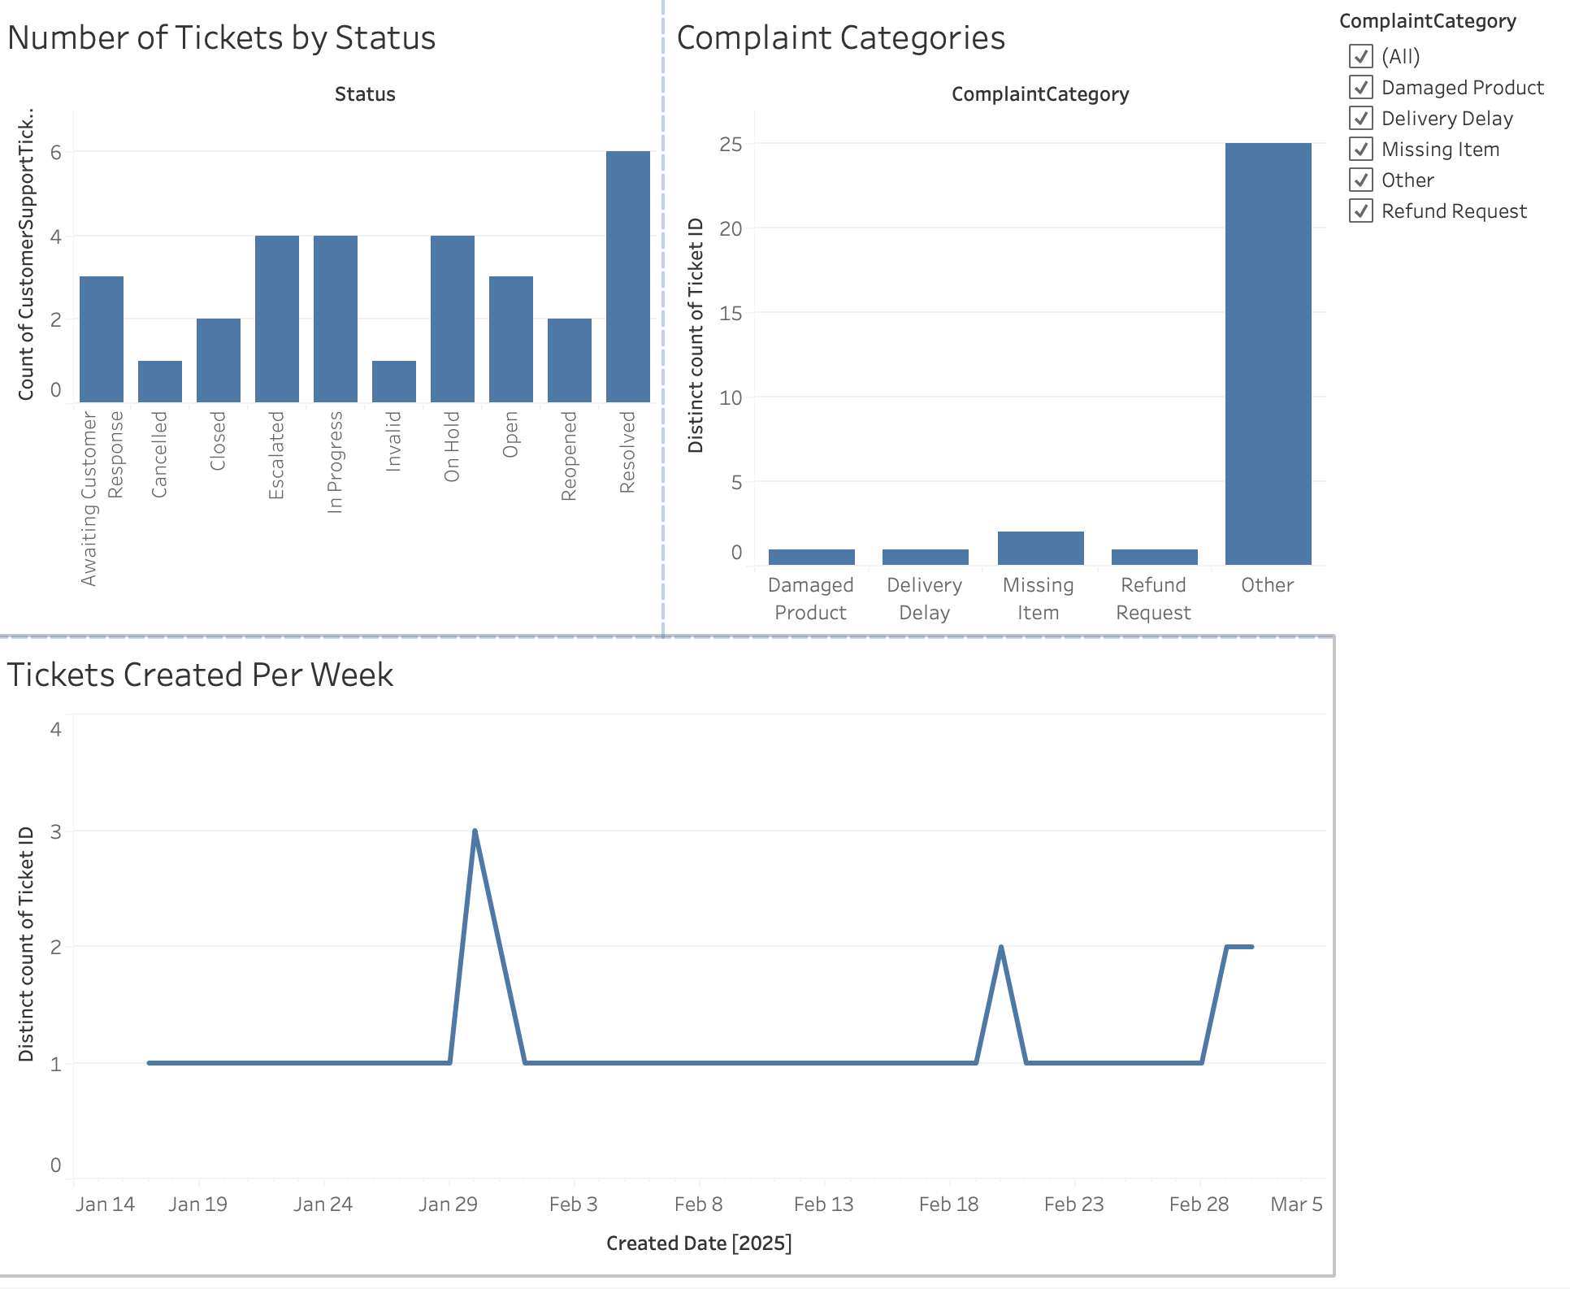
Customer Support Dashboard

Slide 23
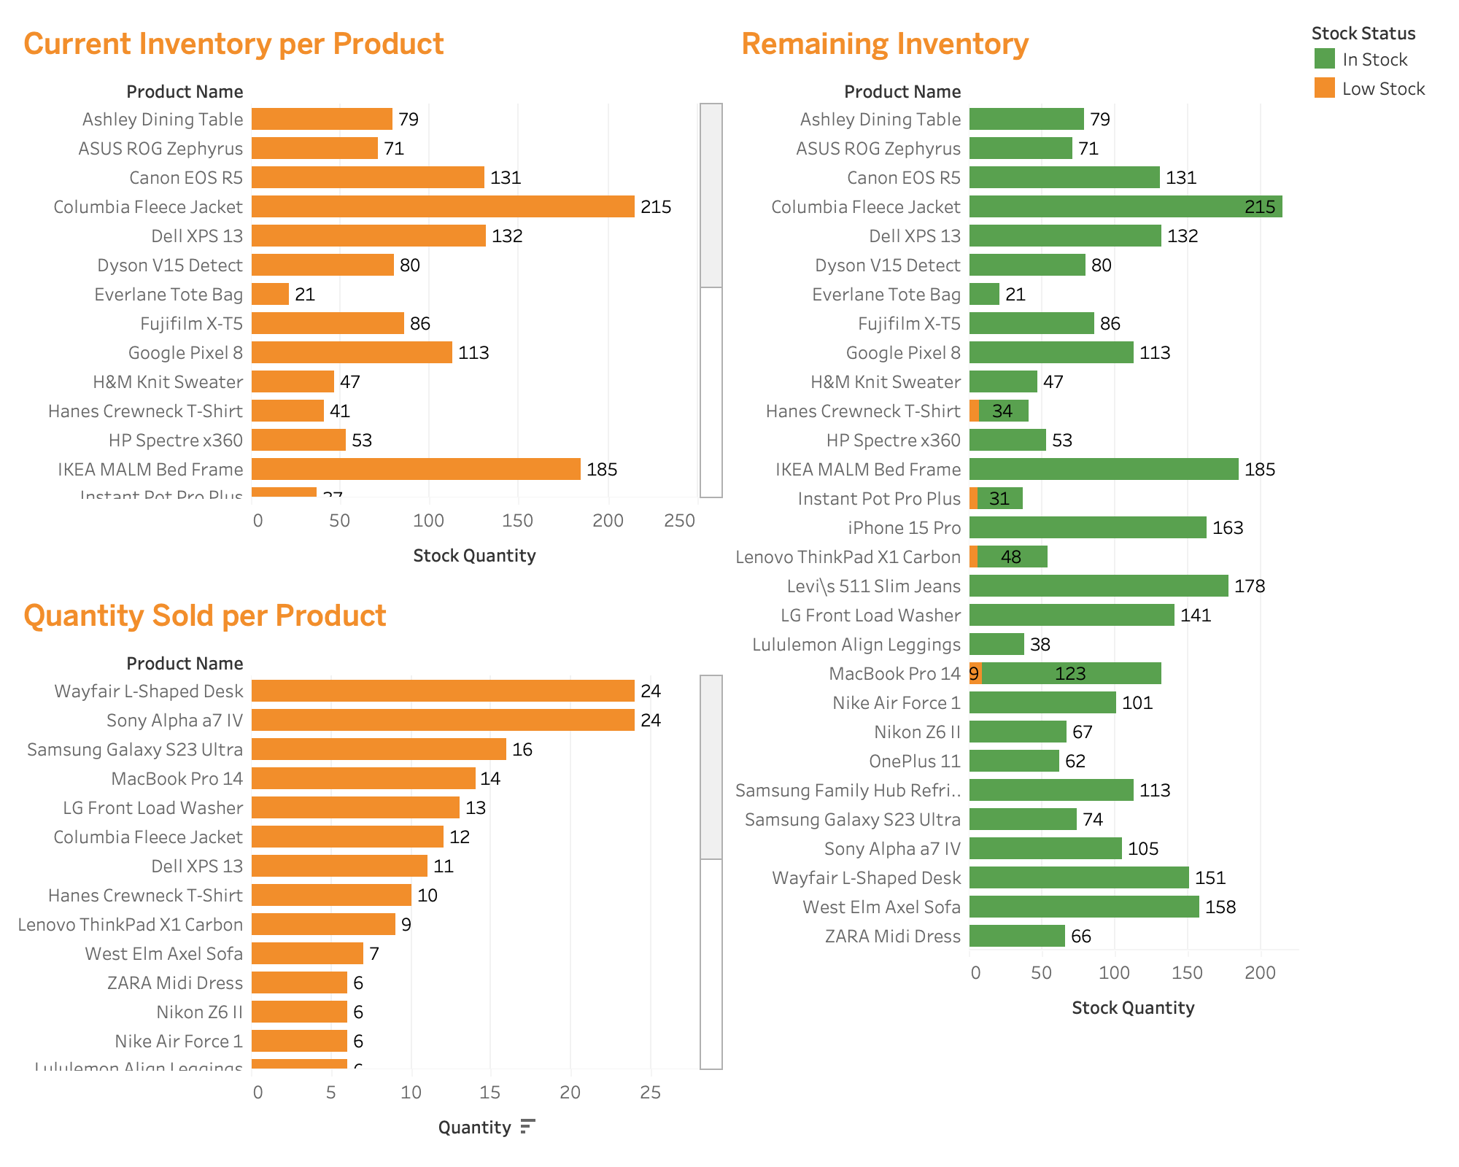
Inventory Dashboard

Slide 24
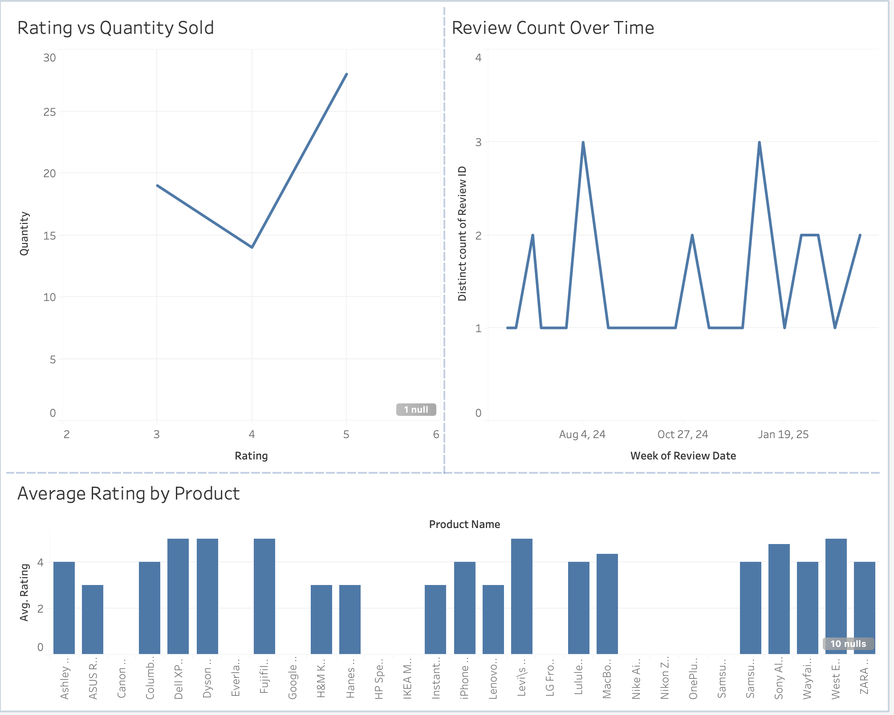
Product Rating Dashboard

Slide 25
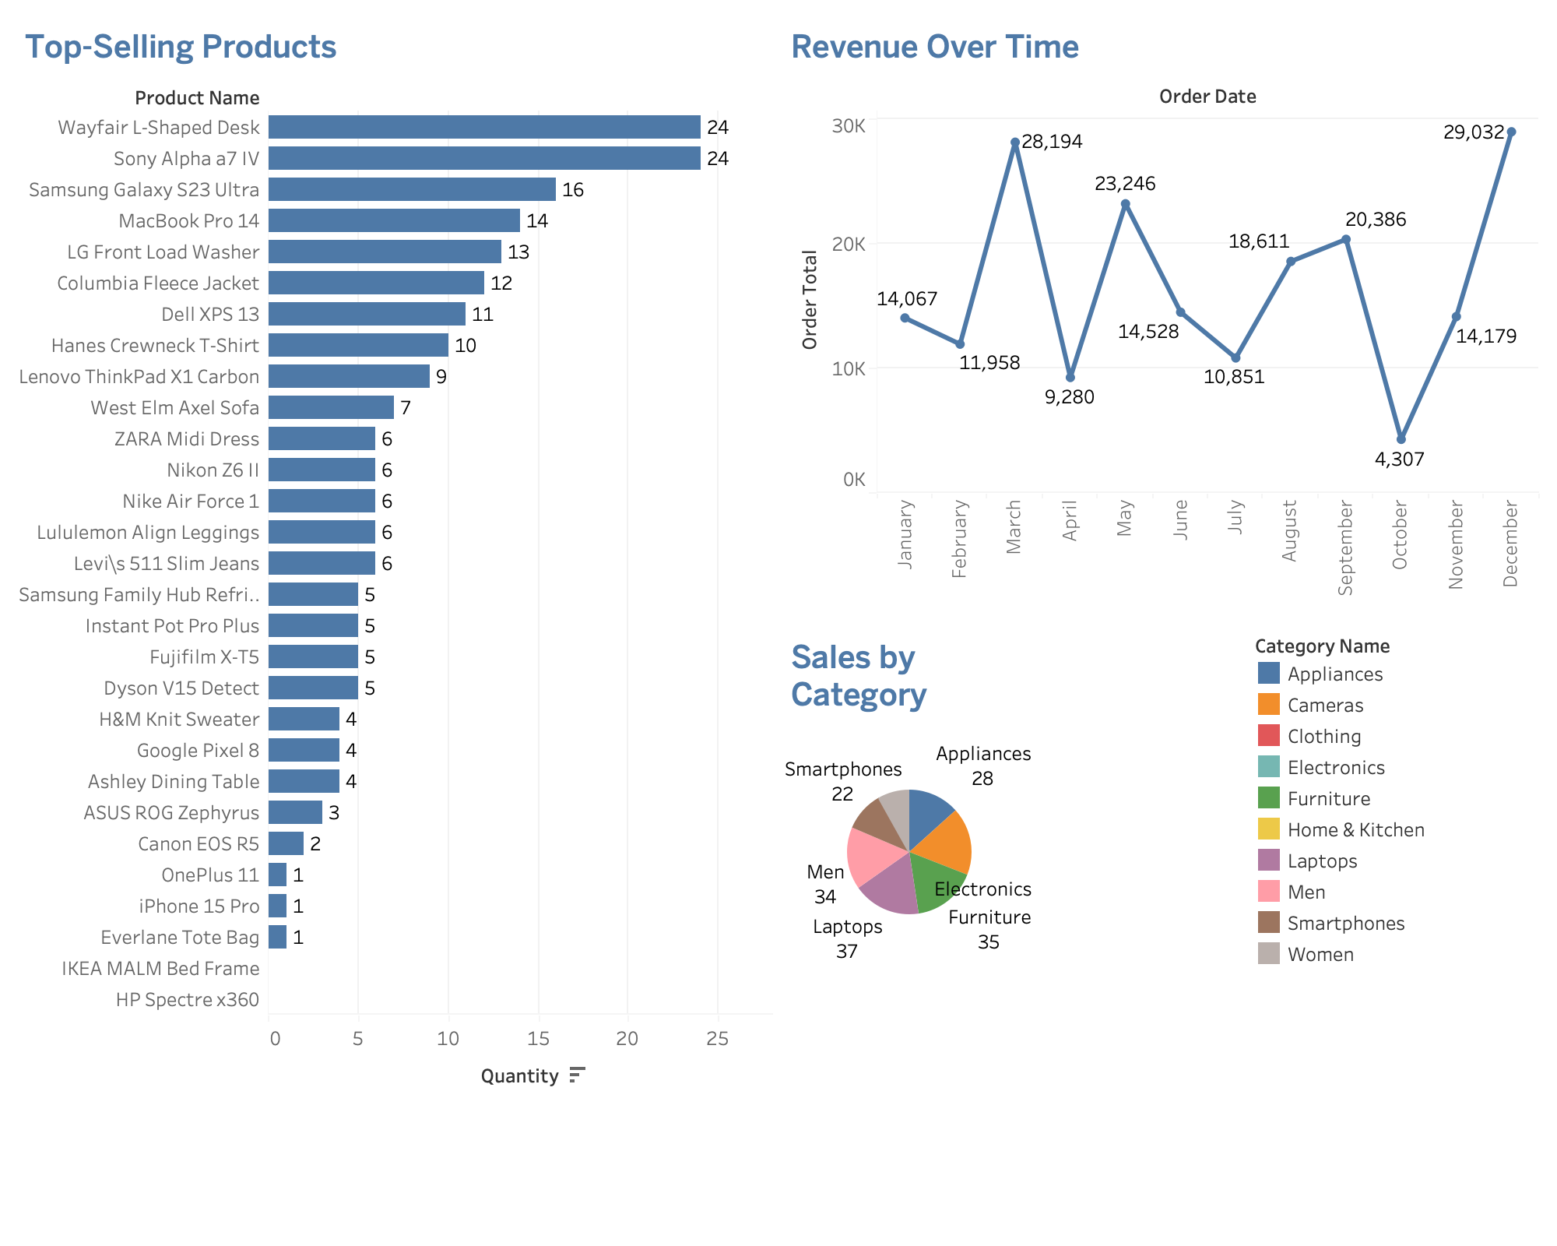
Sales Dashboard

Slide 26
“The Target 2.0 E-Commerce Management System represents a comprehensive and innovative solution that redefines the online shopping experience, empowering businesses to build trust, streamline operations, and drive growth in the digital retail landscape.”
E-COMMERCE (TARGET 2.0) DATABASE MANAGEMENT SYSTEM

Slide 27

Thank You!

